Slide 1
Desktop Pet
Excel Sheets United
Daniel Do
Ethan Brown
Nate Daniels
Nick Kilroe
Jacob Farrell

Slide 2
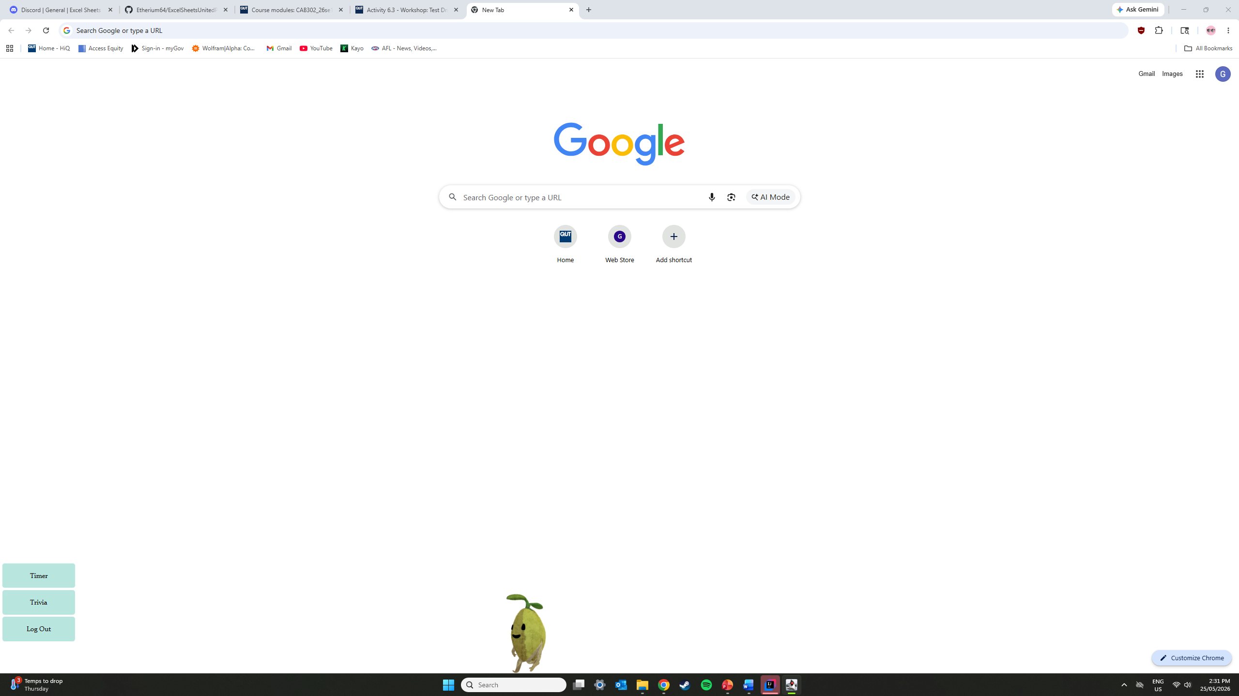
The Problem, the Users, and the Purpose
The Problem:
Working at a desk all day can be dreadfully boring and hard to manage.
The Users:
People who must use a computer for long periods of time to work or study.
The Purpose:
We want to help people to thrive and not just survive in this environment.
Notes:
Use this slide to clearly frame the project before discussing how you worked or what you built. Briefly describe the problem your team aimed to address and explain why it was worth solving. Avoid technical detail here: focus on the motivation and context.
Introduce the intended users of your system and outline their needs, expectations, or challenges as you understood them at the start of the project. This helps the audience understand who the system is for and why certain decisions later in the presentation were made.
Your goal is to establish a shared understanding of what success would look like for this project. This context will anchor later discussion of development practices, teamwork, and quality.

Slide 3
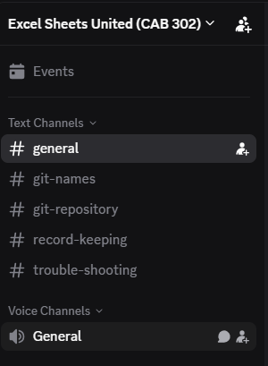
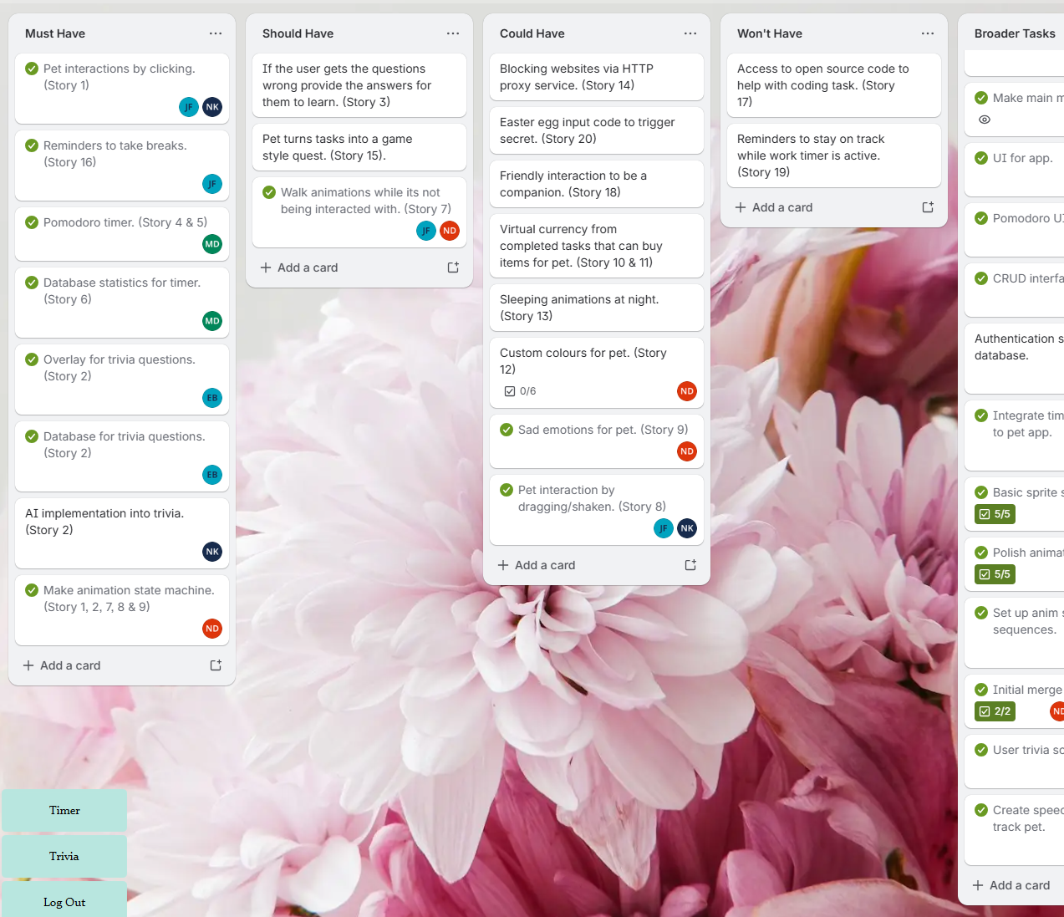
How We Worked as a Team
Team Communication:
Done through an organised server on Discord containing all members.
Project Management:
Trello board for organising user stories and tasks.
Excel sheet recording sprint/release plans and user meetings.
Notes:
Use this slide to explain how your team functioned over time, not just how tasks were divided.
Discuss how you collaborated, communicated, coordinated work, and supported one another throughout the semester.
Strong presentations describe teamwork as an ongoing system of professional practice, rather than a list of individual responsibilities. You may wish to discuss roles, shared ownership, meetings, routines, or communication practices that shaped how your team worked.
Where relevant, reflect on how your team adapted to challenges or changed its way of working. This helps demonstrate learning and maturity in understanding how effective teams operate in practice.

Slide 4
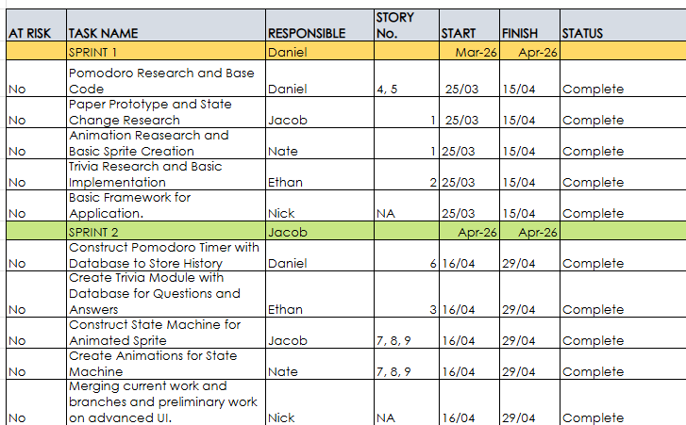
Development Approach and Key Technical Decisions
Organisation:
Weekly meetings for members to catch up and relay progress, roadblocks, and future tasks.
Agile Practices:
Sprint and release plan organised in fortnightly blocks allowed clear and concise periods for members to complete required tasks.
Key Decisions:
Key application features were designed around division of work between five members.
Notes:
This slide should explain how you approached development and the reasoning behind key choices.
Describe the agile practices, processes, or ways of working you adopted, and explain why these were appropriate for your project and team.
You may also highlight important technical or design decisions and how they aligned with your development approach.
Focus on why these choices made sense in context, rather than listing tools or frameworks.
Stronger presentations show how development practices, technical decisions, and team capabilities influenced one another, rather than treating them as separate concerns.

Slide 5
Quality Across the System
Quality In Code:
Working software.
Effective UI.
Good documentation.
Quality Beyond Code:
Consistent communication and collaboration.
Considerations:
User interaction and usability was an important aspect to consider when designing the application.
Notes:
Use this slide to discuss what quality meant for your project, taking a broad view.
Quality can be viewed from multiple perspectives. Strong presentations show an understanding that system quality is multifaceted and is shaped by technical decisions, development practices, teamwork, and how users interact with the system. Consider how process, collaboration, design, usability, clarity, documentation, and interaction all contributed to the system as a whole.
Explain how user considerations influenced design and evaluation but also reflect on how development practices and teamwork supported or constrained quality.
This is an opportunity to show integrated thinking about quality across multiple dimensions. More sophisticated presentations demonstrate that quality is sustained throughout the process, not something assessed or added at the end.

Slide 6
Key Lessons and Professional Insights
Key Positives:
Weekly meetings made for effective collaboration.
Created environment of shared responsibility.
Allowed members to work as a system despite individualised tasks.
Key Learnings:
Poor initial agile management led to poor progress.
Caused limited feature development and inconsistent human-centred design decisions.
Fixing this in future project will set us up for success.
Good agile management techniques equals quality project development at every level.
Notes:
Conclude your presentation by reflecting on what you learned through the project. Use this topic to reflect on your experience and demonstrate what you have learned as a developing software professional.
Focus on insights related to teamwork, development practices, quality, or professional ways of working.
You may discuss challenges, setbacks, or successes, and explain how these experiences shaped your understanding of effective software development in a team context.
Avoid simply repeating earlier points, and rather aim to synthesise and reflect.
Stronger reflections show how learning from this project would influence how you would approach future projects or professional practice.

Slide 7
Final Slide (Not Marked): Task Distribution
At the end of your presentation, leave a final slide on screen during Q&A that shows:
Team member names
Primary areas of contribution
This slide is not assessed and is intended only to support discussion and questions.
Nate: Animation state machine and state change machine for pet.
Ethan: Trivia module and management of GitHub repository.
Daniel: Pomodoro timer and authentication system.
Nick: Integrated application framework between features.
Jacob: State change machine for pet and UI.
Notes:
This slide should remain visible during questions and answers. It should simply and clearly indicate each team member’s primary areas of contribution.
This slide is not assessed and should be factual and concise. Its purpose is to support discussion and individual questioning, not to justify contributions or performance.

Slide 8
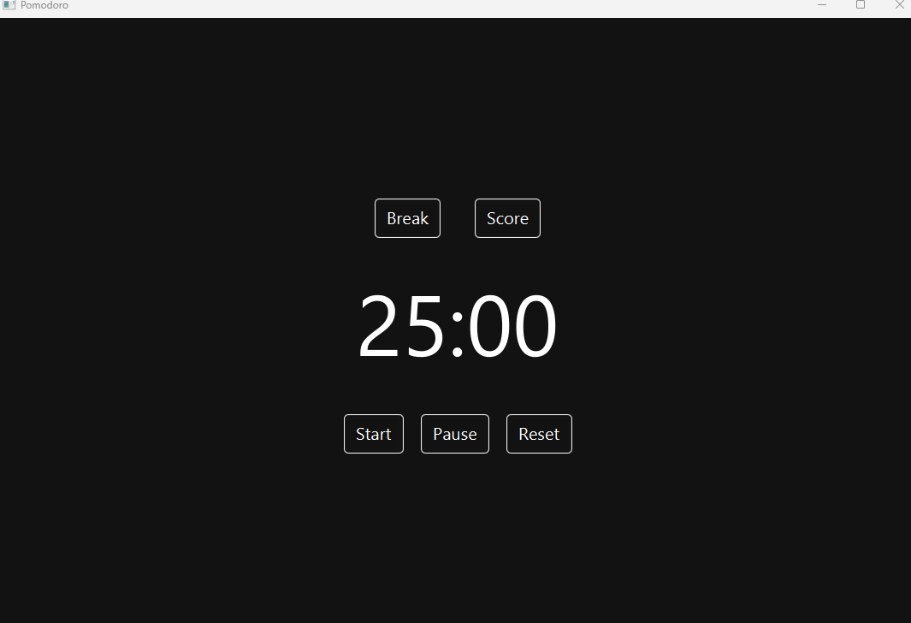

Slide 9
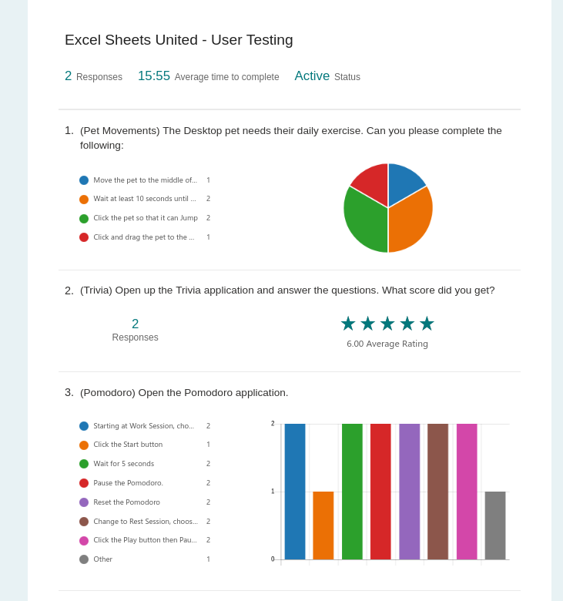
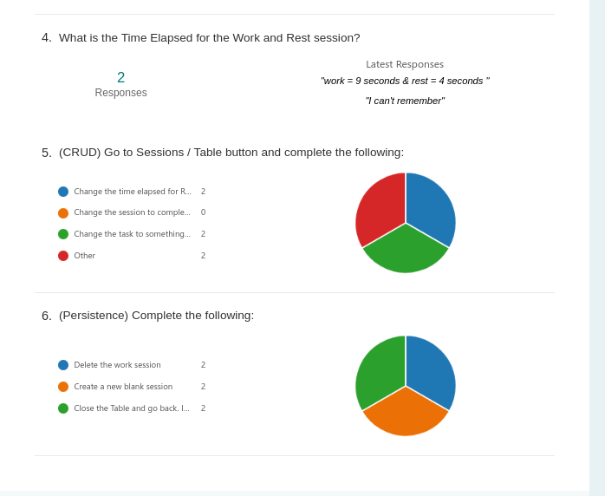

Slide 10
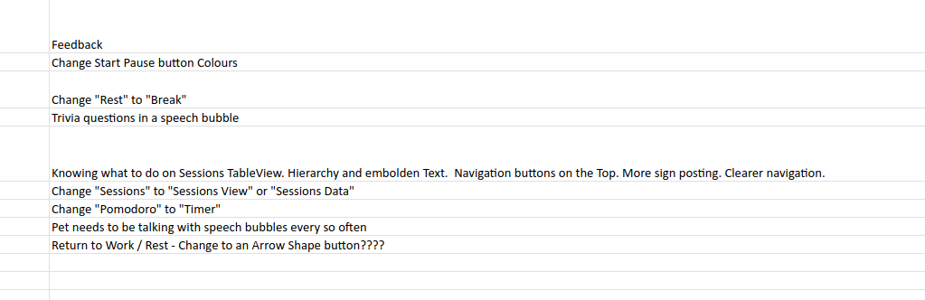
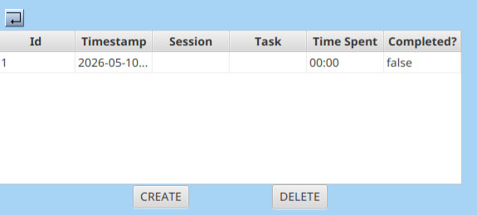
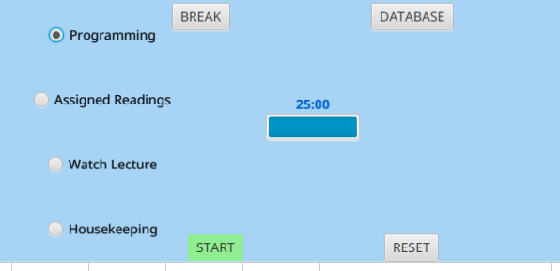

Slide 11
